Slide 1

SOLAR PANAL : A RENEWABLE ENERGY

Slide 2
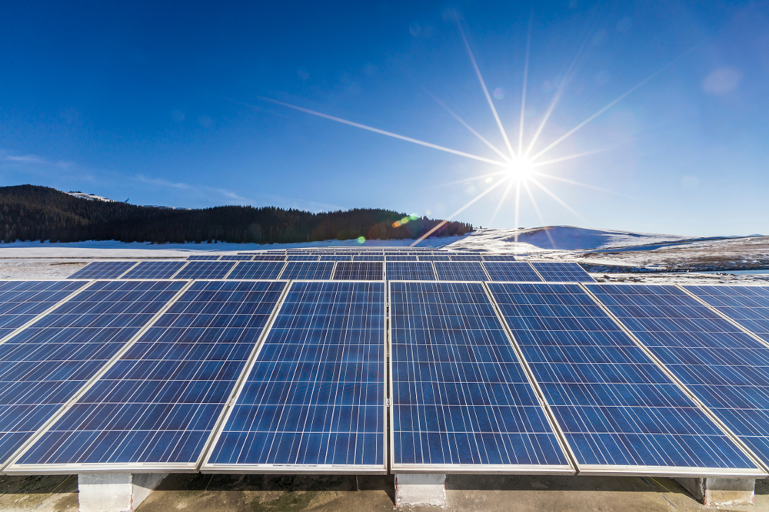


What is solar panal?
Solar energy begins with the sun. Solar panels (also known as "PV panels") are used to convert light from the sun, which is composed of particles of energy called "photons", into electricity that can be used to power electrical loads.
Solar panels can be used for a wide variety of applications including remote power systems for cabins, telecommunications equipment, remote sensing, and of course for the production of electricity by residential and commercial solar electric systems.

Slide 3
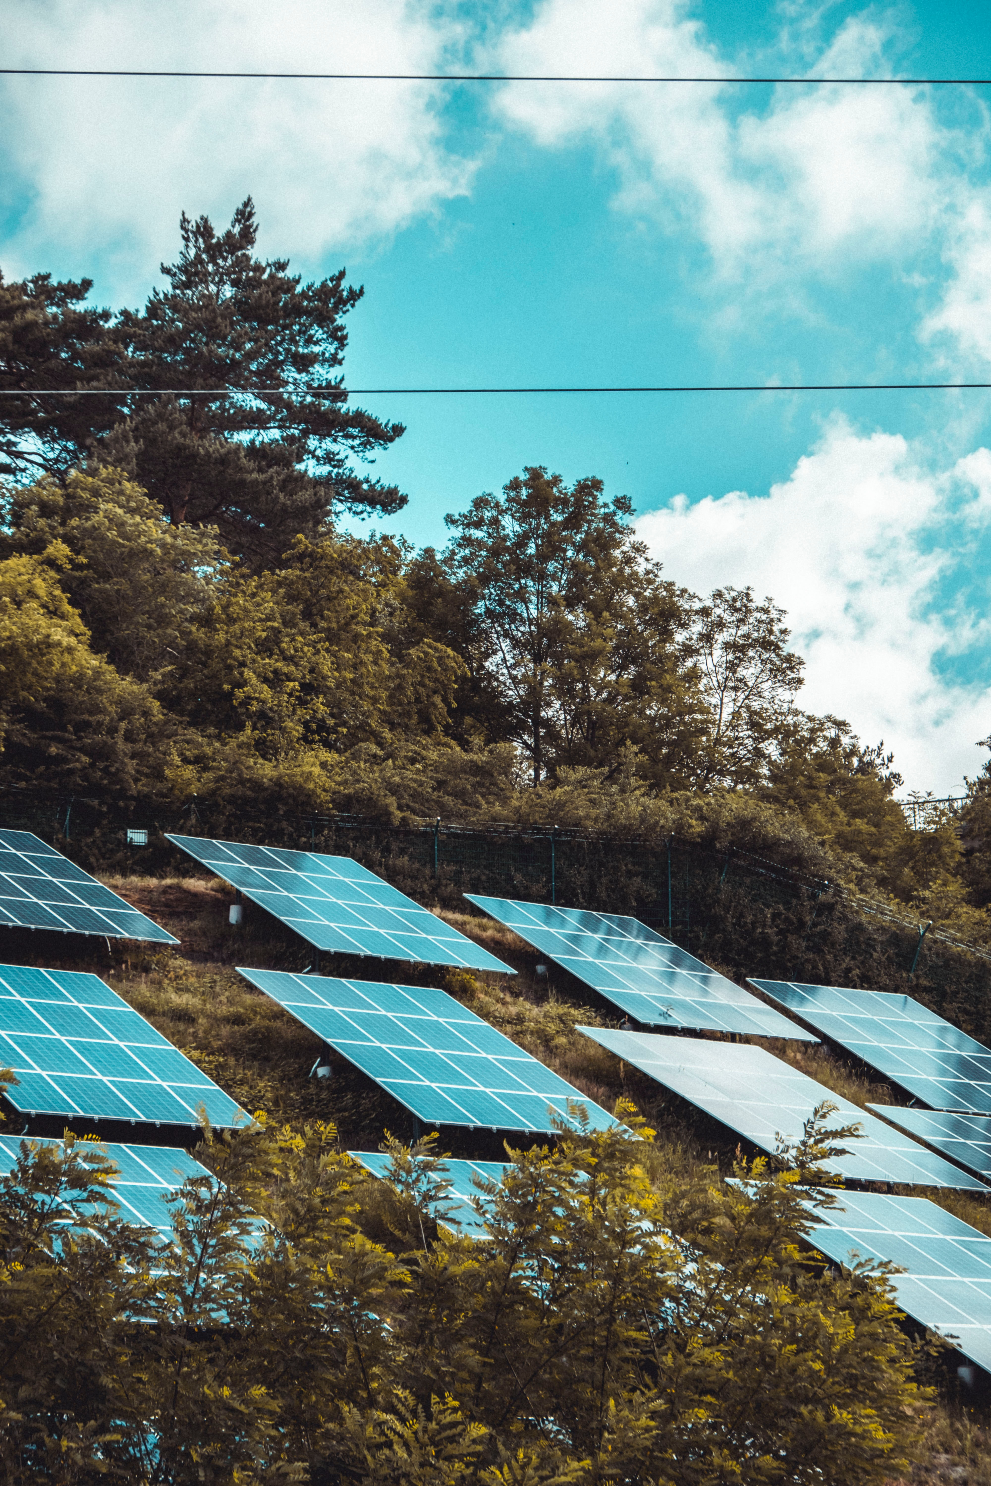
Why should we choose solar panel:
We decided to choose solar Panels as our green technology
Due to our interest in Panasonic and solar city,
Specifically the implementation of solar roofs, an alternatives
To traditional roof types.

Slide 4
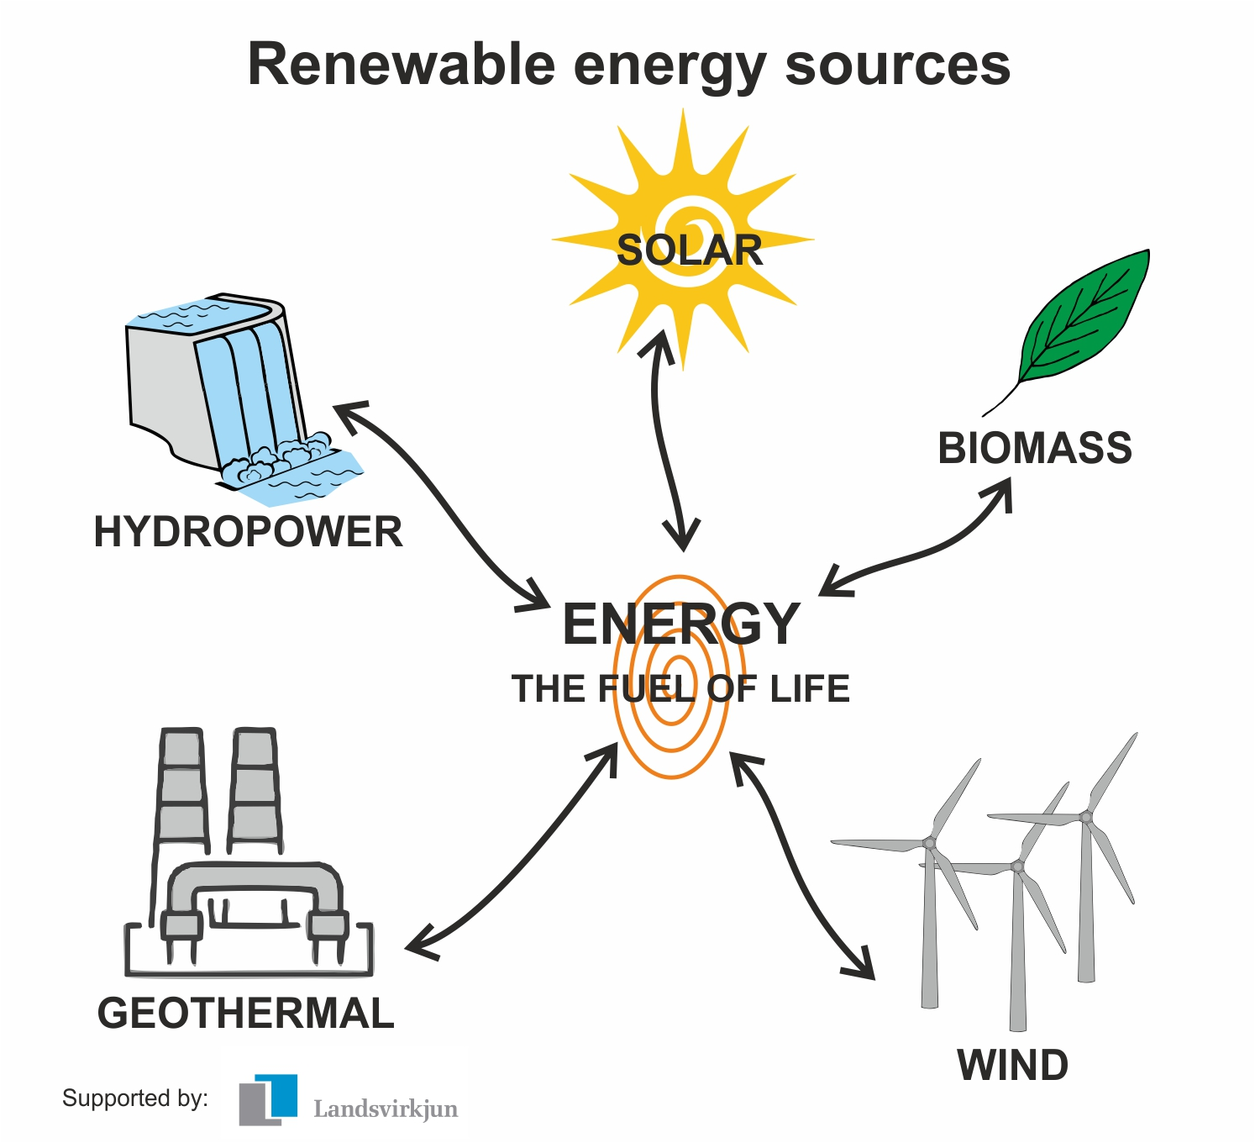
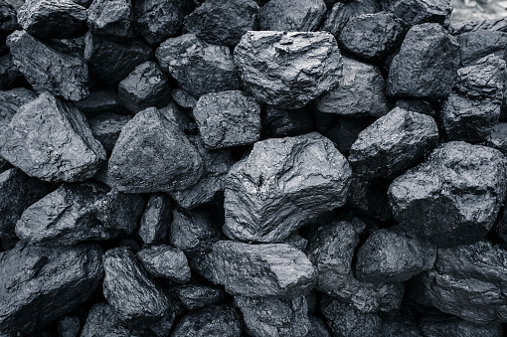
What is solar panel?
Renewable source
Non-renewable source

Slide 5
There are two types of power plants:
1. Solar cell power plant
2. Solar thermal power plant

Slide 6
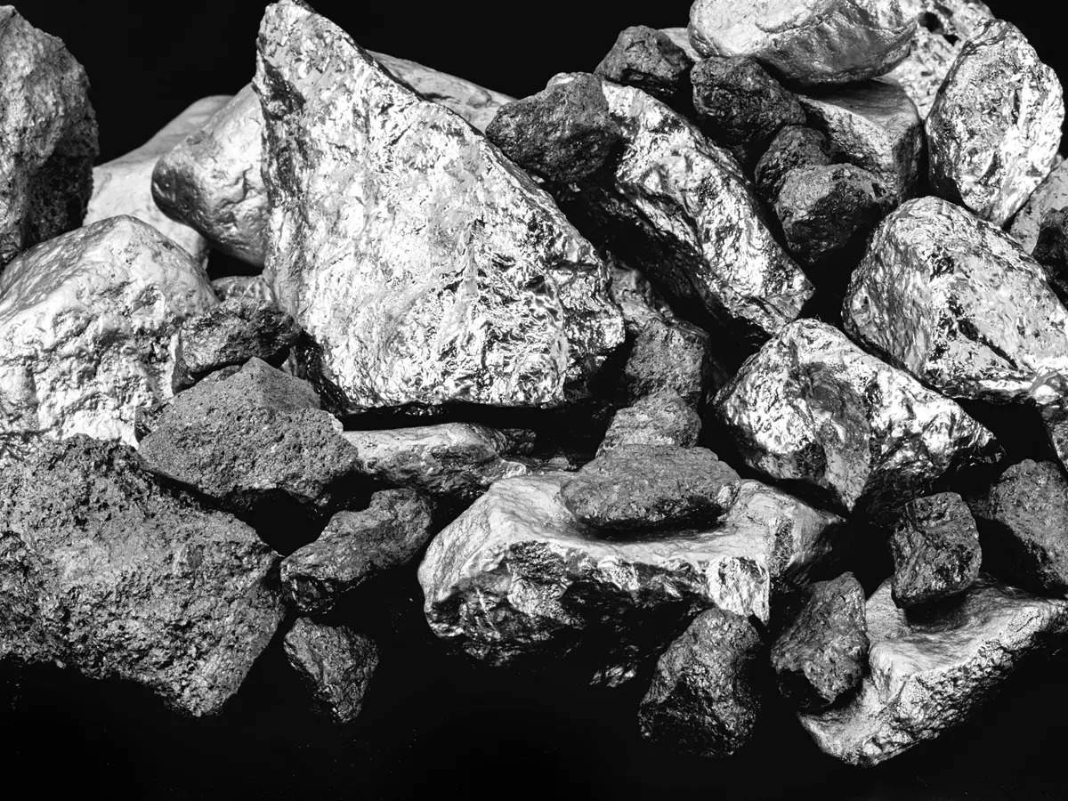
How the solar panel form
Length:160micrometre
Pure silicon

Slide 7
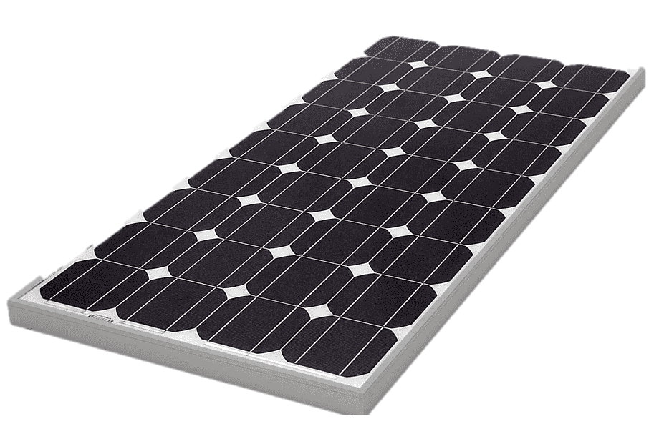
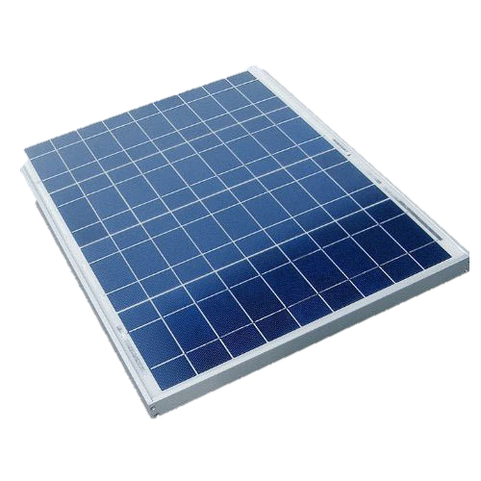
Types of Solar panel
1)Mono crystalline
2)Poly crystalline

Slide 8
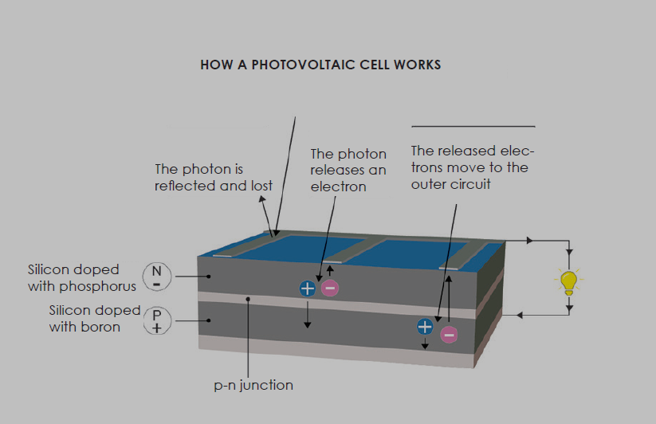
how solar panel works?

Slide 9
Is that total sun energy is used
to produce electricity?
NO
Only 20% to 25%

Slide 10

List of Solar Power Plants / Solar Parks in India
Sl.No | Solar Power Park in India
1 | Bhadla Solar Park, Rajasthan
2 | Pavagada Solar Park, Karnataka
3 | Kurnool Ultra Mega Solar Park, Andhra Pradesh
4 | NP Kunta, Andhra Pradesh
5 | Rewa Ultra Mega Solar, Madhya Pradesh

Slide 11
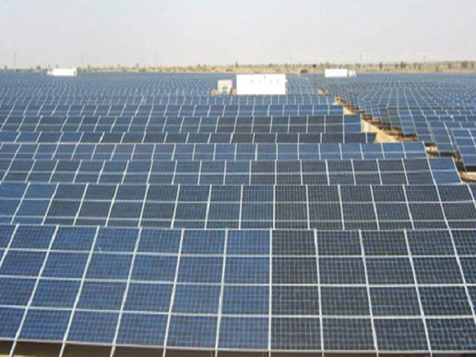
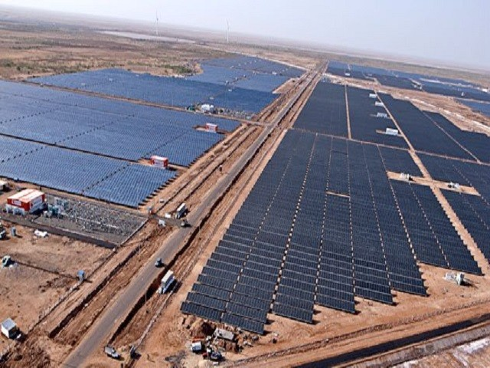
1. Bhadla Solar Park, Rajasthan
Location: Jodhpur district of Rajasthan
Power Generation: 2055 MW
Area of Park: 14000 acres
It is the world's biggest solar park in terms of power generation and second largest in terms of area. The average temperatures in Bhadla range between 46 and 48 degrees centigrades. The geography is quite against the solar plant as hot winds and sand storms cover the place frequently. Bhadla is a sandy, dry and arid region spread in about 45 square kilometres. The average money spent in the plant is around 10,000 crore.
2. Pavagada Solar Park
Location: Palavalli, Karnataka
Power Generation: 2000MW
Area of Park: 13000 acres
This solar park is located in Karnataka which is estimated to be hosting many solar plants due to its highly supportive geography. It has become operational since last year and is the second biggest solar power parks in the world in terms of energy. Shakti Sthala Pavagada Solar Park in Karnataka is one of the world’s biggest solar parks in the country.

Slide 12
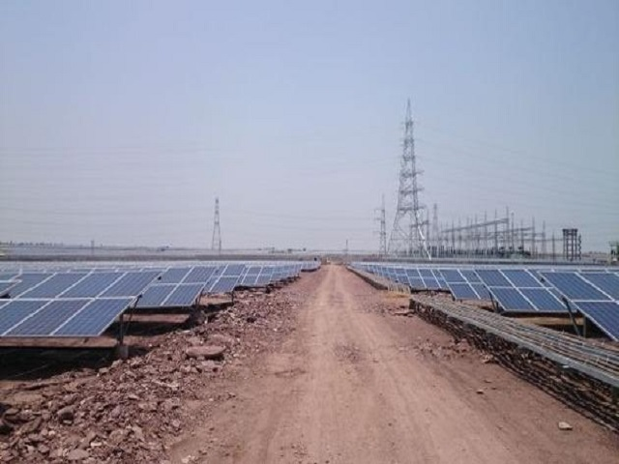
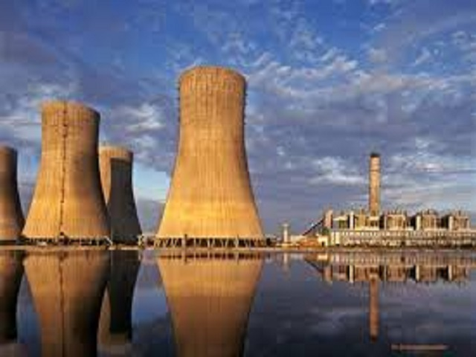
3. Kurnool Ultra Mega Solar Park, Andhra Pradesh
Location: Kurnool, Andhra Pradesh
Power Generation: 1000 MW
Area of Park: 5932 acres
Kurnool Ultra Mega Solar Park is spread over 5,932.32 acres of area in Kurnool district of Andhra Pradesh and is one of the world’s largest solar park at the time. This plant was set up within two years by Andhra Pradesh Solar Power Corporation jointly with Solar Energy Corporation, Andhra Pradesh Generation Corporation and New and Renewable Energy Development Corporation using INR 7,143 crore.
4. NP Kunta Ultra Mega Solar Park
Location: Anathapuram, Andhra Pradesh
Power Generation: 1500 MW
Area of Park: 7924 acres
This solar park is also known as Ananthapuram Ultra Mega Solar Park is spread over a total area of 7,924.76 acres in Nambulapulakunta Mandal in the Ananthapur district of the Indian state of Andhra Pradesh. Commissioned in May 2016, this park is owned by Andhra Pradesh Solar Power Corporation Private Limited, APSPCL.

Slide 13
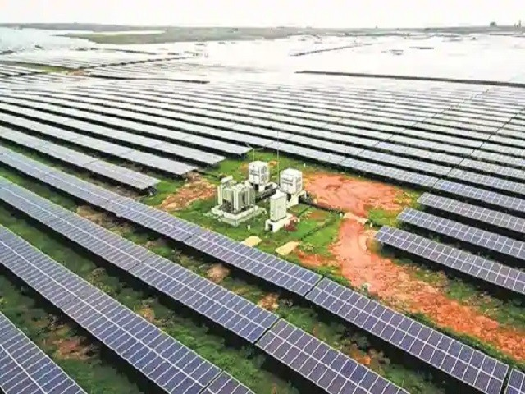
5. Rewa Ultra Mega Solar Plant
Location: Rewa, Madhya Pradesh
Power Generation: 750 MW
Area of Park: 1590 acres
Rewa Ultra Mega Solar Limited (RUMSL), is the agency responsible for the implementation of the project. It is a joint venture between the Madhya Pradesh Urja Vikash Nigam Limited (MPUVNL) and the Solar Energy Corporation of India (SECI).
Usage in india
2017–18 | 25.87
2018–19 | 39.27
2019–20 | 50.13
2020–21 | 60.40

Slide 14


advantages
Dis advantages
Reduced electric bill
Insurance against rising energy costs
Cheaper power source
Return on investment
Environmentally friendly
Energy independence
High initial cost
Intermittent energy source
Uses a lot of space
Small amount of pollution during manufacture, transport and installation
Not ideal if you plan on moving house
Location of solar cells

Slide 15
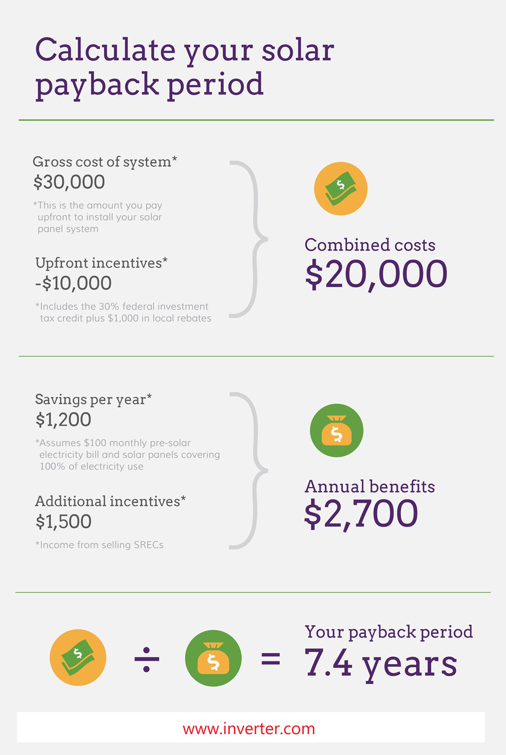

How to Calculate Solar Payback Period?
Not many investments are as risk free and profitable as installing a solar system. Today, the payback period of solar installation is as less as 2 to 3 years.
Pay back period is the time taken to break-even or to get back your solar investment. Calculating the payback period for solar panels is easy but you need to understand certain components of the investment before you begin.

Slide 16




Presented by
Presented by:

Slide 17



COMPANY
RESOURCES
CONTACT

